Slide 1
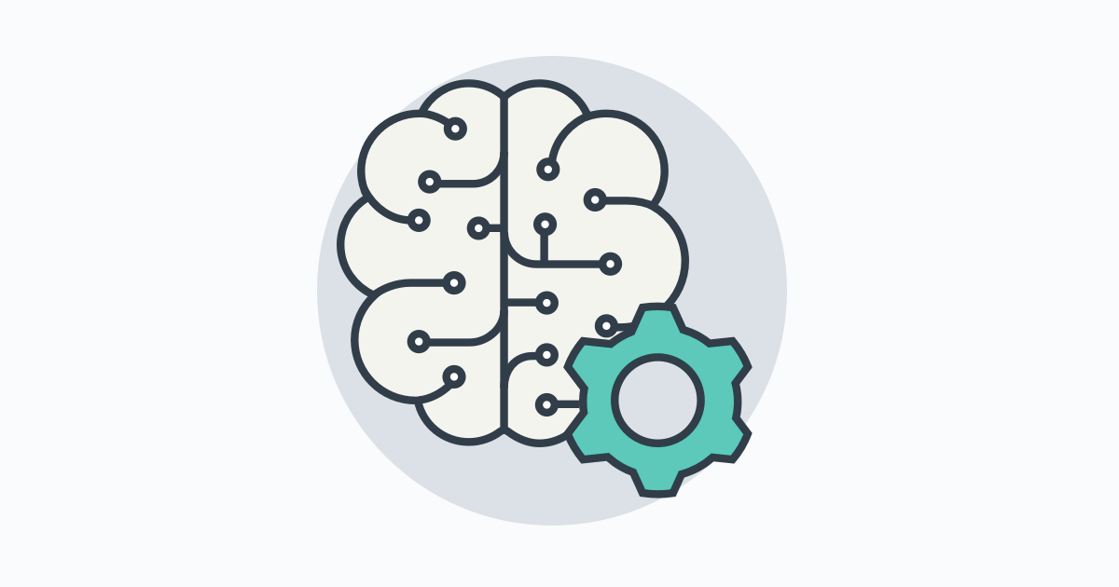
Introduction to Artificial Intelligence

Slide 2
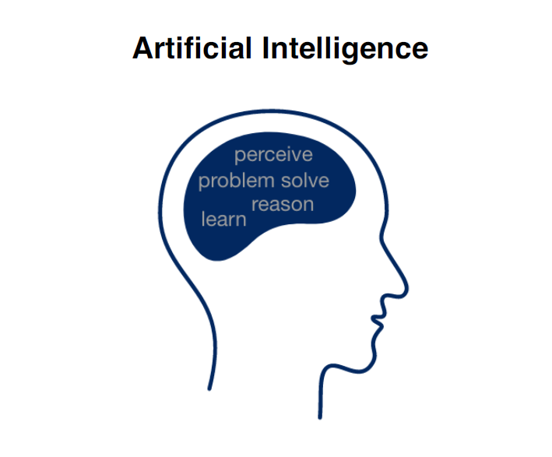

Slide 3
AI is most feasible when:

Slide 4
AI is most feasible when:
The task doesn’t require much thinking/reasoning
Lots of data is available

Slide 5
Anything you can do without much thought,
AI can do.
Input | Output | Application
Audio | Text transcript | Speech Recognition
Music | Like/not like | Music Recommendation
Photo | Image identification | Computer Vision
English | Chinese | Translation
Text | Meaning | Sentiment Analysis

Slide 6
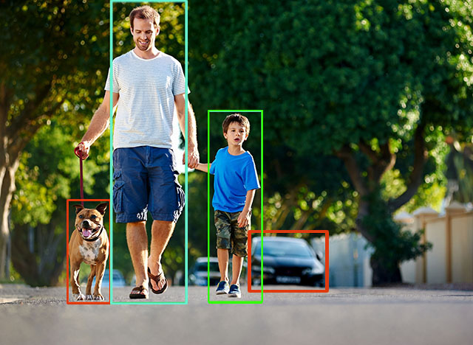
Understanding what’s in an Image

Slide 7
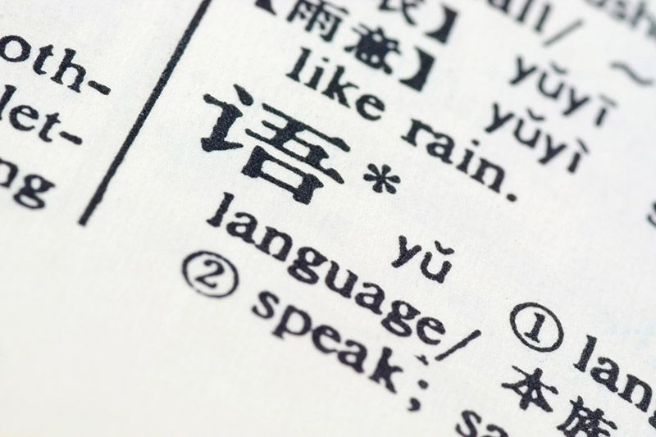
Understanding language

Slide 8
Natural Language Processing

Slide 9
Email:
The shirt that I purchased was for an event but it doesn’t quite fit. Can I return it?

Slide 10
Email:
The shirt that I purchased was for an event but it doesn’t quite fit. Can I return it?
AI can respond by determining its category:
“Refund Request”, “Order Inquiry”, “Shipping”, or “Other”

Slide 11
Email:
The shirt that I purchased was for an event but it doesn’t quite fit. Can I return it?
AI can respond by determining its category:
“Refund Request”, “Order Inquiry”, “Shipping”, or “Other”
“Refund Request”

Slide 12
Email:
The shirt that I purchased was for an event but it doesn’t quite fit. Can I return it?
AI cannot respond with empathy:
“Sorry that the size didn’t work out.”
“Of course, you can return the shirt.”
“I hope your event goes well.”

Slide 13
Sentiment Recognition

Slide 14
Sentiment Recognition
We enjoyed the food and the service was great.

Slide 15
Sentiment Recognition
We enjoyed the food and the service was great.

Slide 16
Sentiment Recognition
We enjoyed the food and the service was great.
We had to wait for an excessive amount of time and our order was wrong.

Slide 17
Sentiment Recognition
We enjoyed the food and the service was great.
We had to wait for an excessive amount of time and our order was wrong.

Slide 18
Informational Retrieval

Slide 19
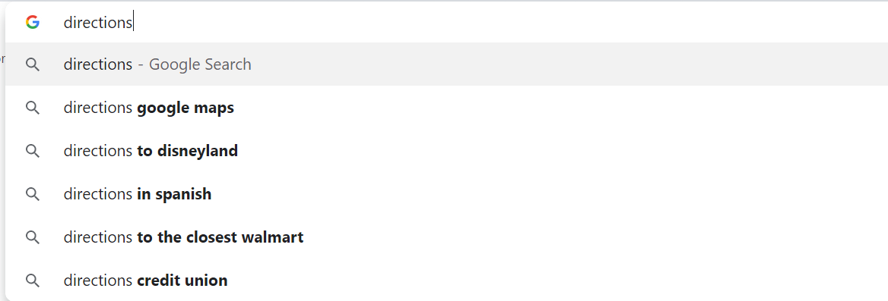
Informational Retrieval

Slide 20
Machine Translation

Slide 21
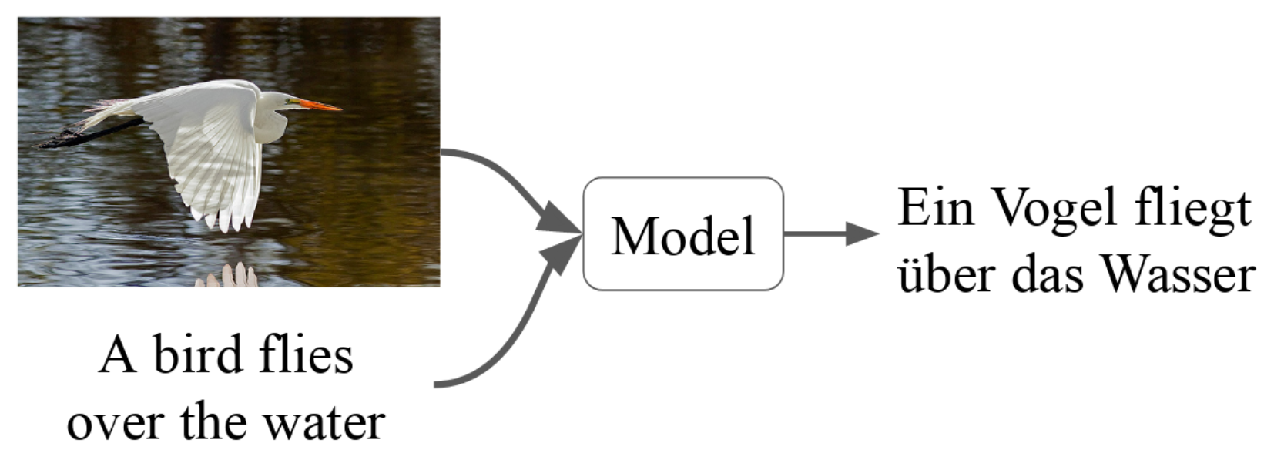
Machine Translation

Slide 22
你好
English
Chinese
Hello
再見
Goodbye

Slide 23
Speech

Slide 24
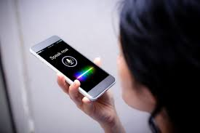
Speaker ID

Slide 25
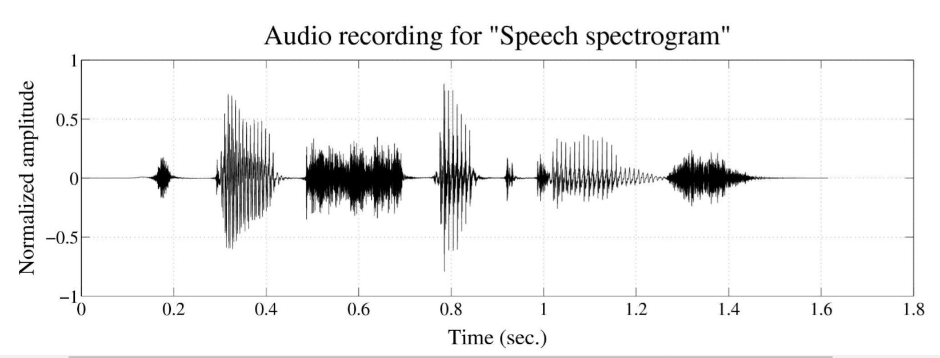
Speech Recognition
(speech-to-text)

Slide 26

Speech Synthesis
(text-to-speech)
Becoming human.

Slide 27
Computer Vision

Slide 28
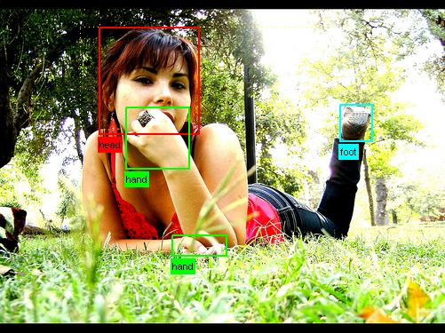
Understanding what’s in an Image

Slide 29
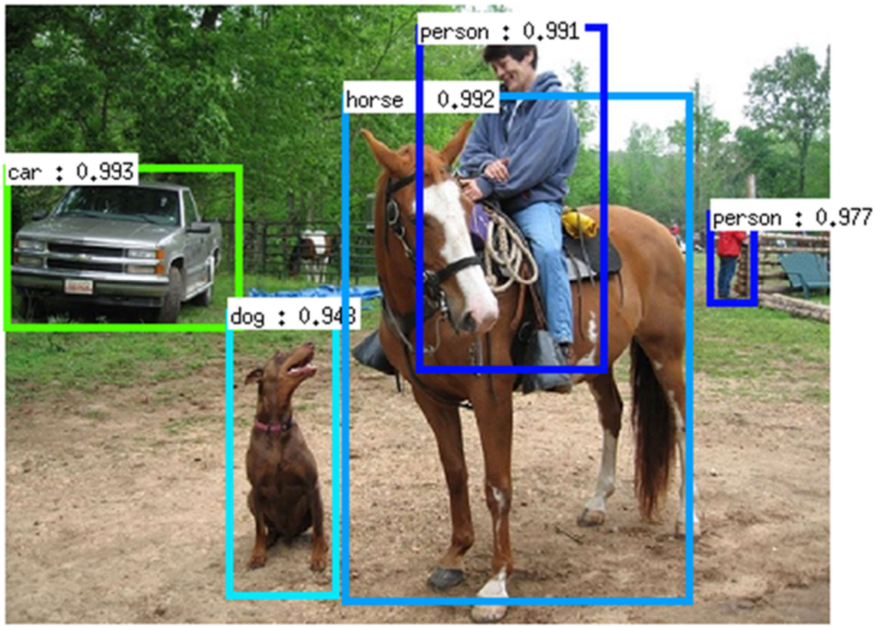
Object Detection

Slide 30
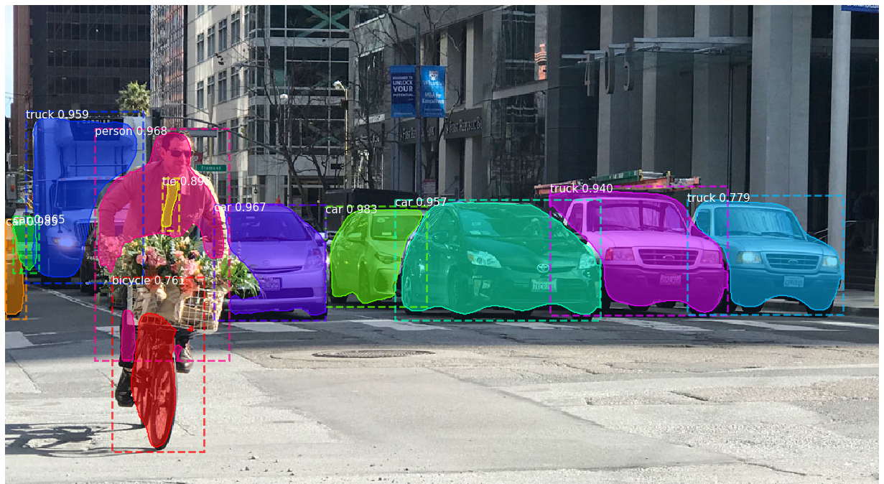
Image Segmentation

Slide 31
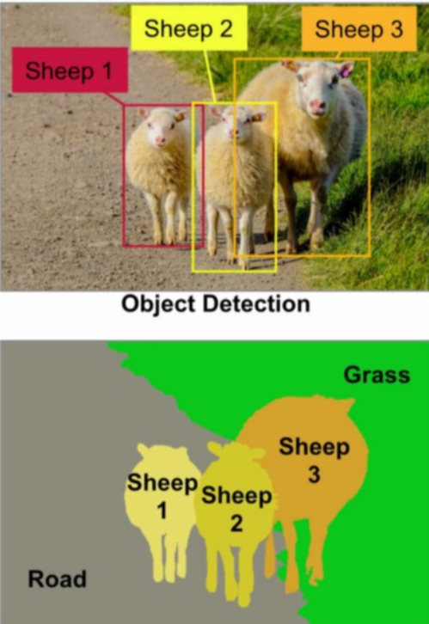
Object Detection
Image Segmentation

